Slide 1
Course Technicalities
Following the course Moodle is important
The course grade is determined by a single written exam at the end of the course
Seminar Paper is an alternative to the exam. These include a review and small programming project related to the course content
There will be group assignments that include a series of questions about the course content and readings
You will upload your responses to the assignments to Moodle and they will discussed in class
The grading of assignments is pass/fail, and the group might be asked to do a better job if necessary.

Slide 2

Course Outline
The first part of the course includes:
Presentation of facts about the human brain
Introduction to methods for studying the brain
General overview of types of machine learning approaches to Cognitive neuroscience
The following parts will cover:
Modeling of individual concepts and relationships between concepts (representational geometry)
Core topics of human cognition, including:
Learning
Memory
Language processing
Attention
Discussion of errors that neural nets make and what this means for them as models of cognition.

Slide 3
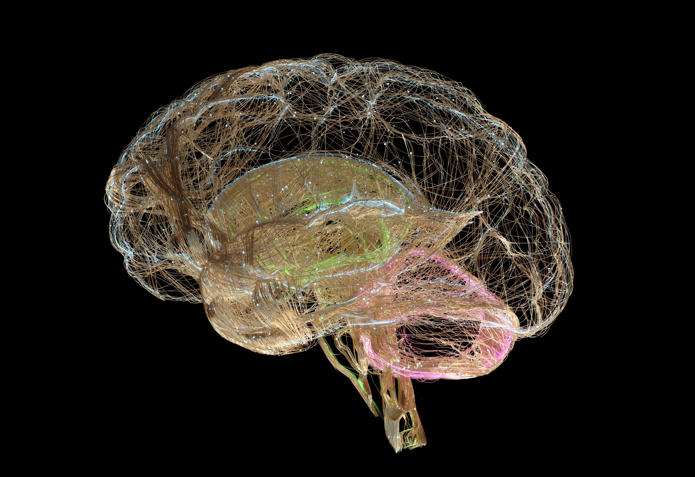
Intro to brain physiology and research methods

Slide 4

Outline
Section 1: Basic facts about the human brain
Section 2: Studying the human brain (tools, and basics of experimentation)

Slide 5

Section 1: Basic facts about the human brain
What are the main lobes and subcortical structure
What is a neuron
What is the difference between gray and white matter

Slide 6
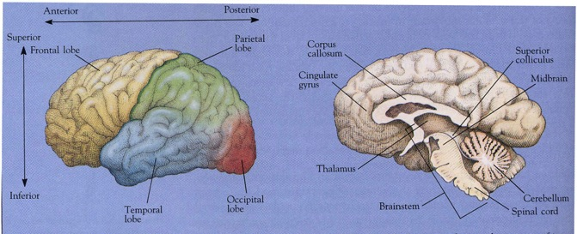
Gross partitioning and function: Cortex
Temporal lobe: Auditory processing (hearing and language)
Parietal lobe: Attention, touch, saccade planning
Frontal lobe: Planning, execution, higher level cognition, high level language processing and language production
Occipital lobe: Vision: perception of visual features, categories and location

Slide 7
Gross partitioning and function: other structures
Cerebellum: Fine motor control, implicated in emotional responses
Thalamus: Major gateway for sensory processing. One of the final stops before sensory information arrives at the cortex
Hippocampus: implicated in construction of memories; these are later transferred to other cortical regions
Corpus Callosum: A main “highway” of white matter tracks that connects the two hemispheres

Slide 8
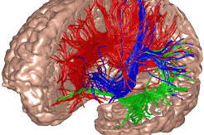
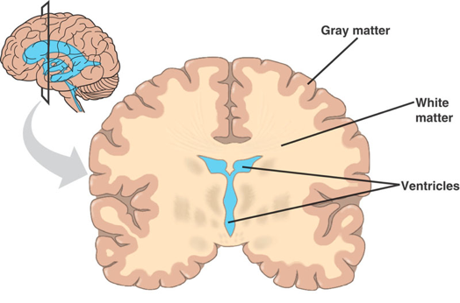
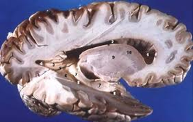
Gray matter
Gray matter (GM) gets its name from its color, which is mainly due to the high density of cell bodies with relatively fewer myelinated axons.
The gray matter regions of the brain are involved in various important functions, such as sensory processing and cognition, and include not only the cerebral cortex but also the cerebellum, basal ganglia, thalamus, and several other regions.
Techniques for measuring brain activity often reflect the function of gray matter regions, which are responsible for the majority of cognitive processing.
As a result, understanding the role and function of gray matter in the brain is essential for gaining insight into various neurological and psychiatric conditions.

Slide 9
White matter
White matter consists mainly of long-range axon pathways, or tracts, that connect different regions of the brain.
Unlike gray matter, there is no direct information processing within white matter itself, but it is essential for efficient communication between different regions of the brain.
The structure of white matter can change with learning because it reflects the long-range neural pathways that carry nerve impulses and facilitate the communication between different regions of the brain.
Damage to white matter, such as the loss of myelin in conditions like multiple sclerosis, can have significant impacts on communication between different regions of the brain, leading to various neurological and psychiatric symptoms.
Therefore, understanding the role and function of white matter is critical for studying brain function and identifying potential targets for interventions in various neurological and psychiatric disorders.

Slide 10
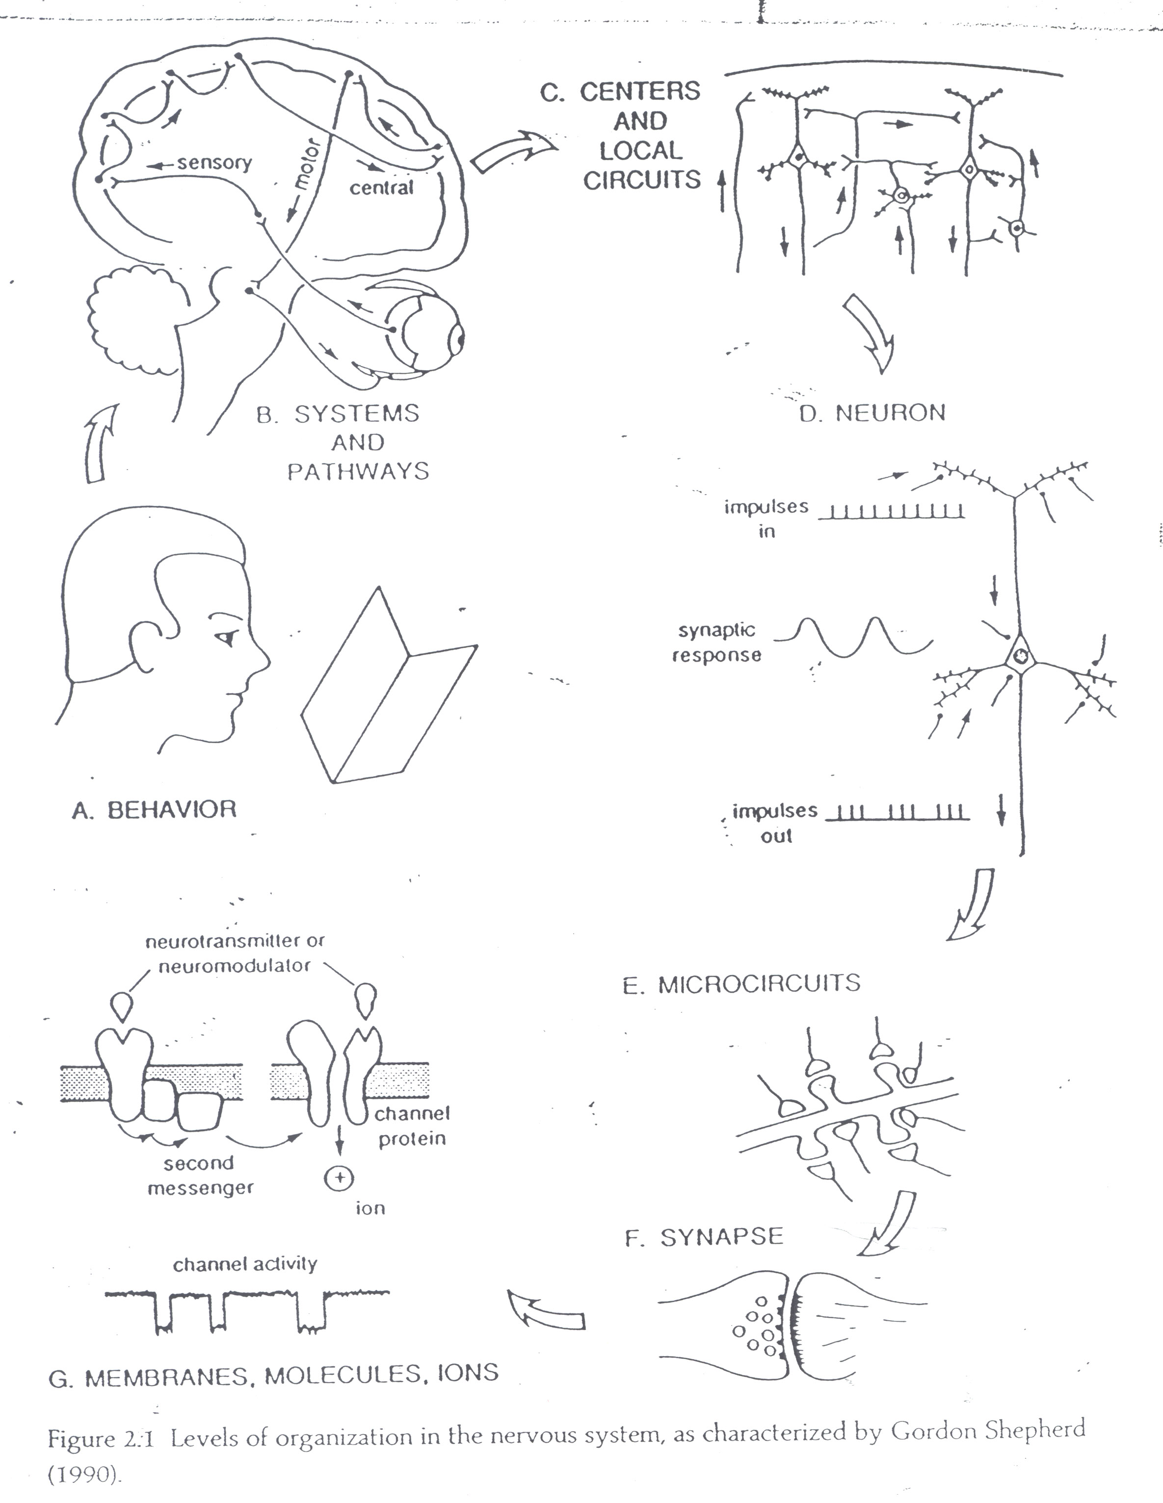

Slide 11
The human brain can be studied at different levels of organization, from systems and pathways to synapses and membranes.
Systems and pathways refer to large-scale neural networks responsible for specific functions, such as sensory perception, motor control, and cognition. These may be topographically distributed.
Circuits and neurons: networks of interconnected neurons that underlie information processing within the brain.
Synapses and membranes: molecular and cellular mechanisms that govern the transmission of signals between neurons, such as the release of neurotransmitters and activation of ion channels.
Studying the brain at different scales provides insights into organization of function from the macroscopic to the microscopic level.

Slide 12
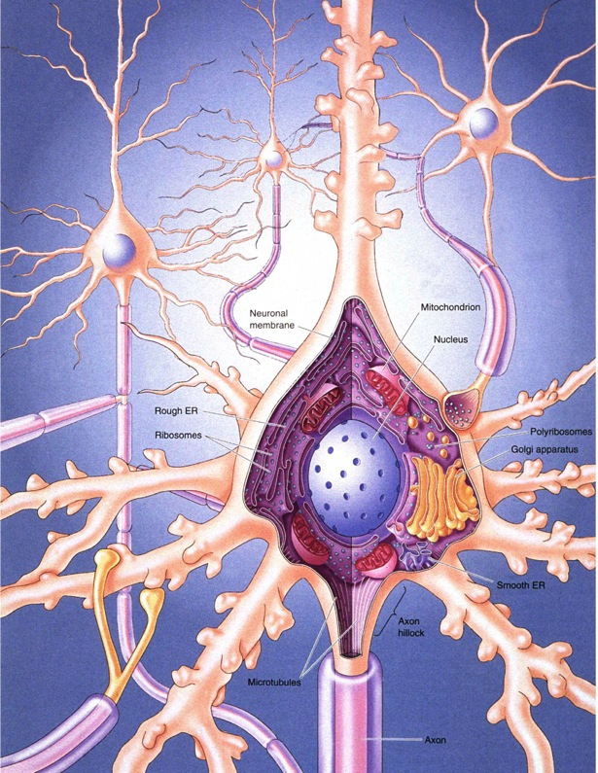
A word about the Neuron
A Neuron consists of dendrites, a cell body and an axon.
Connections between neurons are called synapses, and occur on a neuron’s dendrites, who receive synaptic signals. Synapses are chemical, not electrical. Other neurons will connect on dendrites and in some cases on soma.
A neuron will ‘fire’ (generate an action potential) depending on the the number of signals it receives on its dendrites and their strength, which are ‘summed’ in the neuron’s body.
Dendrite
Cell Body
Axon

Slide 13
A word about the Neuron
A Neuron consists of dendrites, a cell body and an axon.
Connections between neurons are called XX, and occur on a neuron’s XX, who receive synaptic signals. Synapses are XX, not electrical. Other neurons will connect on XX and in some cases on soma.
A neuron will ‘fire’ (generate an action potential) depending on the the number of signals it receives on its dendrites and their XX, which are ‘summed’ in the neuron’s body.
Dendrite
Cell Body
Axon
Notes:
Note to students: make sure you can fill in the XX here

Slide 14
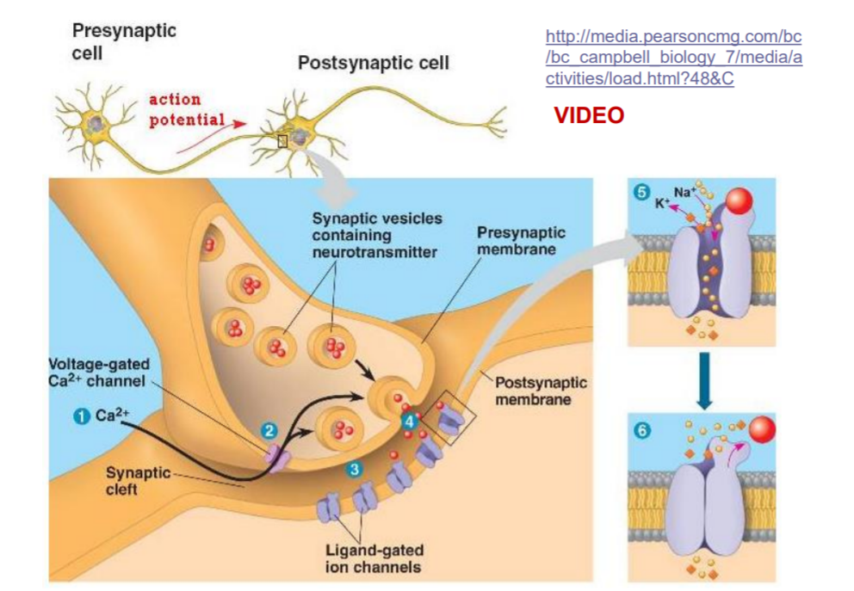
More words about the Synapse: communication

Slide 15
More words about the Synapse: communication
Synaptic communication is the process by which neurons communicate with each other through the release and reception of chemical signals called neurotransmitters.
The presynaptic cell contains several elements that are involved in the release of neurotransmitters, including vesicles and voltage-gated channels.
When an action potential reaches the presynaptic terminal, it triggers the opening of voltage-gated calcium channels, triggering the release of neurotransmitters from the vesicles.
Neurotransmitters diffuse across the synaptic cleft and bind to receptors on the postsynaptic membrane, which triggers the opening of ion channels and the generation of a postsynaptic potential.
The postsynaptic potential can either be excitatory, causing the postsynaptic neuron to depolarize and fire an action potential, or inhibitory, causing the postsynaptic neuron to hyperpolarize and become less likely to fire an action potential.

Slide 16
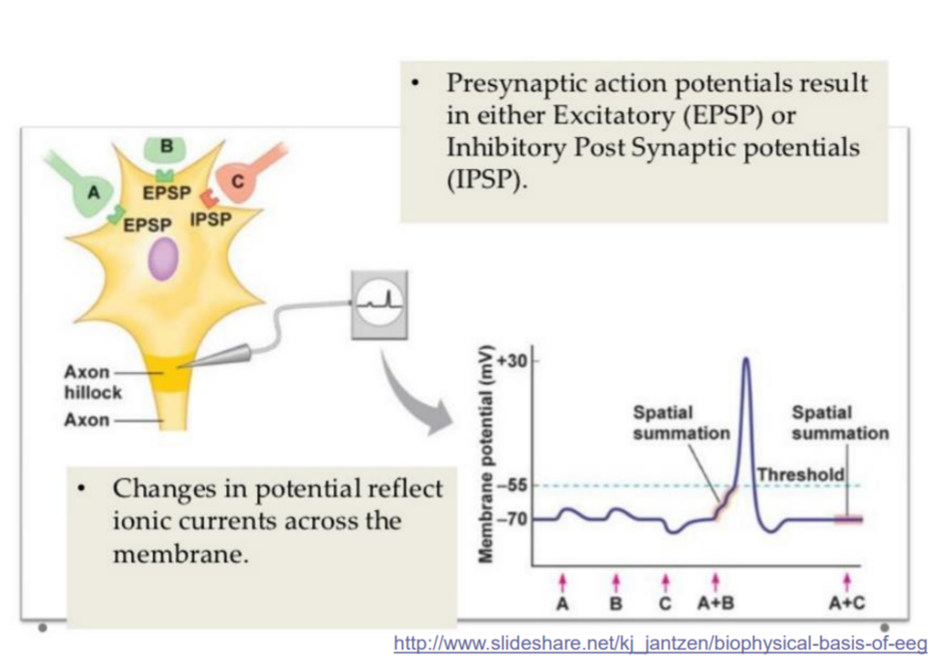
Depolarization produces an ‘all or nothing’ signal. No partial firing.

Slide 17
If we had to say 1 word on plasticity..
Synapses can be strengthened or pruned
Connections between neurons are consistently removed (or created) depending on use.
Weak or ineffective connections are ‘pruned’
Plasticity (in one sense) refers to the development and pruning of connections to adapt to the environment.
A large % of neurons that develop die
Some principles of neuronal survival:
A ‘hub’ Neuron, which receives inputs from many neurons is more likely to survive.
When many neurons connect to a target neuron, this decreases their survival rate.
This calibration is thought to be associated with generating an optimal degree of synaptic connection.
Brain volume triples between birth and adulthood.
This is mostly not due to addition of neurons.
It is due to an increased number of connections (synapses), myelineation of existing axons and greater dendritic branching.

Slide 18
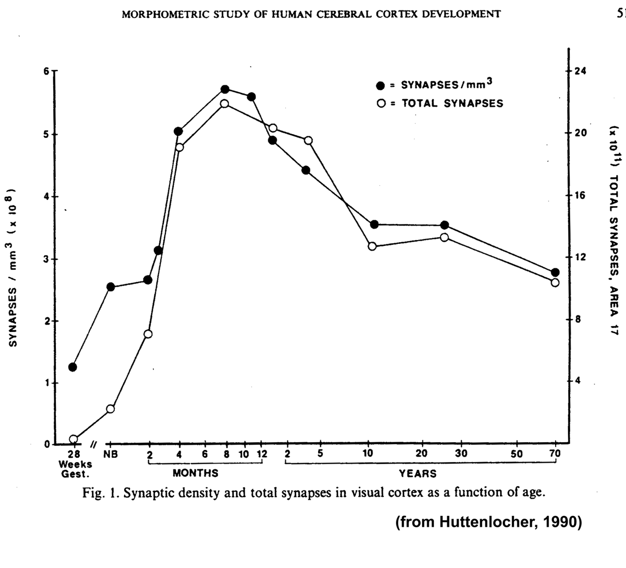
Notes:
Optional

Slide 19
Section 2: Studying the brain
There are several non-invasive tools available for studying brain activity and structure, including electroencephalography, structural imaging, functional magnetic resonance imaging (fMRI), and diffusion-weighted imaging.
These tools provide insights into different aspects of brain function and structure: electrical activity of neurons, the structural connectivity of brain regions, and the metabolic activity associated with specific tasks or behaviors.
Experimental procedures are used to analyze the data collected by these tools, which typically involves designing and conducting studies that involve manipulating variables of interest and collecting and analyzing data from participants.
In neuroscience, an experiment or study is a systematic investigation of a research question or hypothesis that involves manipulating variables and measuring their effects on some outcome of interest.
Conclusions from experiments are drawn by analyzing the data collected from participants and testing whether there are statistically significant differences between groups or conditions.
Typically involves using statistical methods to quantify the strength and direction of effects and assessing the probability that the observed effects are due to chance.

Slide 20
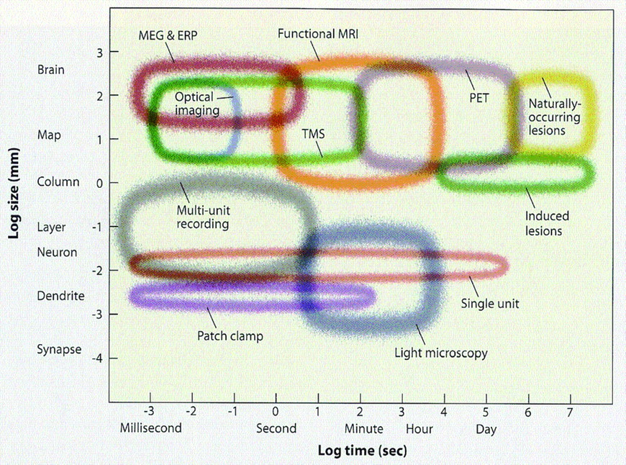
Temporal and spatial scales of common tools

Slide 21
fMRI:
Spatial resolution: typically several millimeters or larger, depending on the voxel size and field strength of the scanner.
Temporal resolution: relatively slow, typically several seconds or longer, due to the sluggish hemodynamic response that fMRI measures.
TMS (transcranial magnetic stimulation):
Spatial resolution: relatively poor, typically on the order of centimeters or larger, depending on the location and size of the coil.
Temporal resolution: relatively fast, on the order of milliseconds or shorter, since TMS can directly stimulate neurons and induce changes in neural activity.
Induced lesions:
Spatial resolution: depends on the size and location of the lesion, which can vary widely.
Temporal resolution: relatively slow, since the effects of the lesion may take days or weeks to become apparent.
MEG:
Spatial resolution: relatively good, on the order of millimeters or less, depending on the number and location of the sensors.
Temporal resolution: very fast, on the order of milliseconds or shorter, since MEG measures the magnetic fields generated by neural activity directly.
Patch clamp (current recording from ion channels in cell membrane):
Spatial resolution: very good, on the order of micrometers or less, since the patch clamp technique can record from individual neurons or even subcellular compartments.
Temporal resolution: very fast, on the order of milliseconds or shorter, since the patch clamp technique can measure changes in membrane potential with high precision.

Slide 22
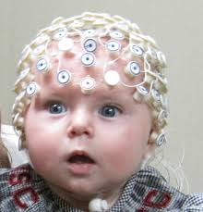
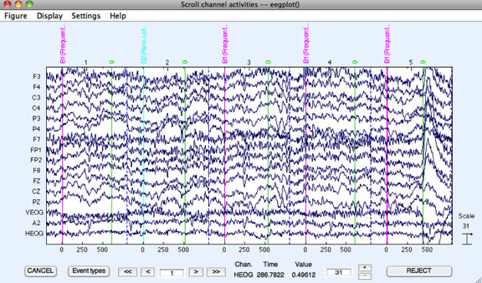
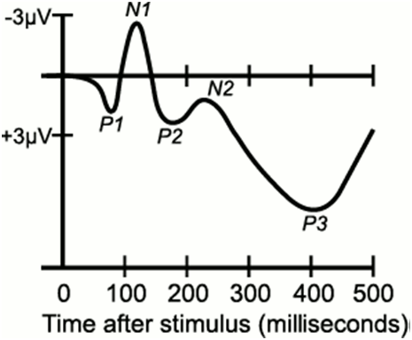
Electroencephalography (EEG)
EEG is a non-invasive method used to study patterns of brain activity with high temporal resolution.
The principle behind EEG is that it is sensitive to very subtle changes in electric potentials below the sensors, which are propagated to the scalp. These changes reflect alterations in the electrical environment of thousands of neurons that fire in synchrony.
It is difficult to pinpoint the brain regions causing the fluctuations, but the timing of the signals is very precise.
Tasks can generate stereotyped evoked potentials that can be averaged to obtain an "event-related potential".
EEG provides a powerful tool for investigating the dynamics of neural activity in the brain, and is widely used in both research and clinical settings

Slide 23
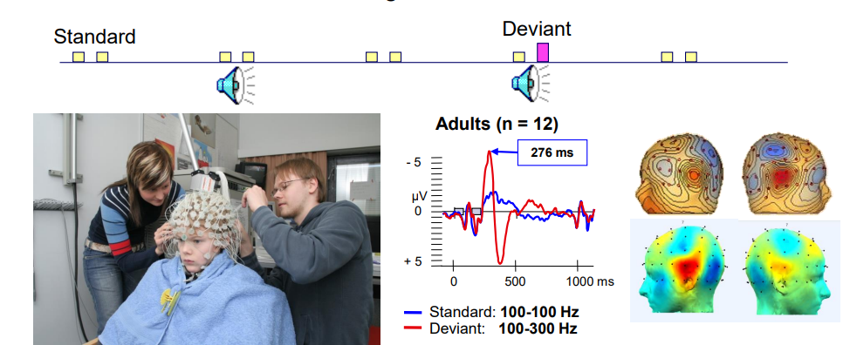
From EEG time series to ERP
An Evoked-Response-Potential analysis quantifies electrical brain responses to events/ stimuli based on time-locked EEG portions.
Presents an analysis of time-locked brain activity at resolution of ms.
Can be used as the basis for more sophisticated analysis such as source localization.
Notes:
From eppanen hamalainen eeg-tool-for-brain

Slide 24
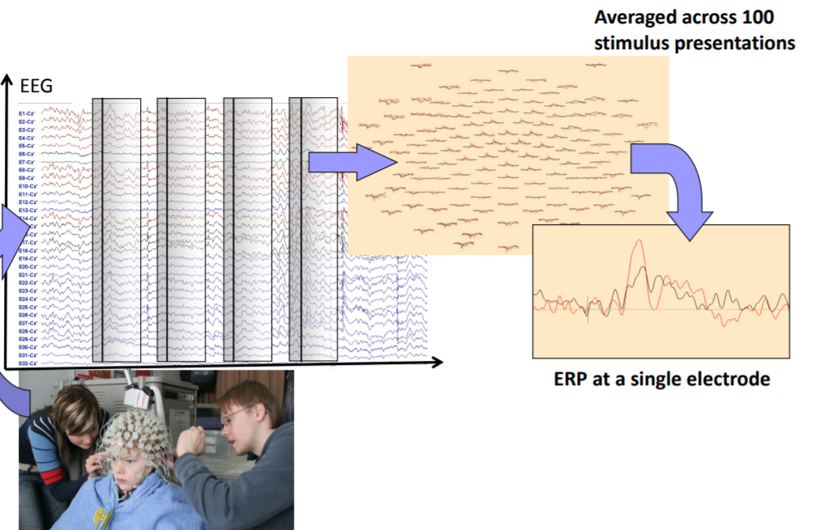
From EEG time series to ERP
Notes:
From eppanen hamalainen eeg-tool-for-brain

Slide 25
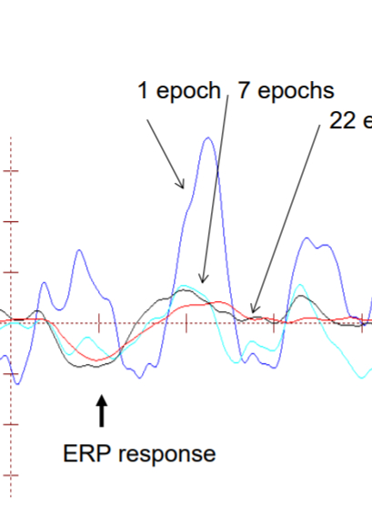
‘Signal’ in brain low. Noise high.
The impact of noise on computing ERPs scales down (or reduces) as a function of the square root of the number of observations (N). For example, for 381 observations, the noise reduction factor would be approximately 1:19.
This noise reduction applies to each timepoint measured.
For accurate results, many repetitions of each condition are needed.
The need for many repetitions can be challenging and time-consuming, but it is necessary for obtaining reliable and statistically significant results.
In addition to repetition, other techniques such as filtering and artifact rejection can also help reduce noise in EEG recordings.
Notes:
From eppanen hamalainen eeg-tool-for-brain

Slide 26
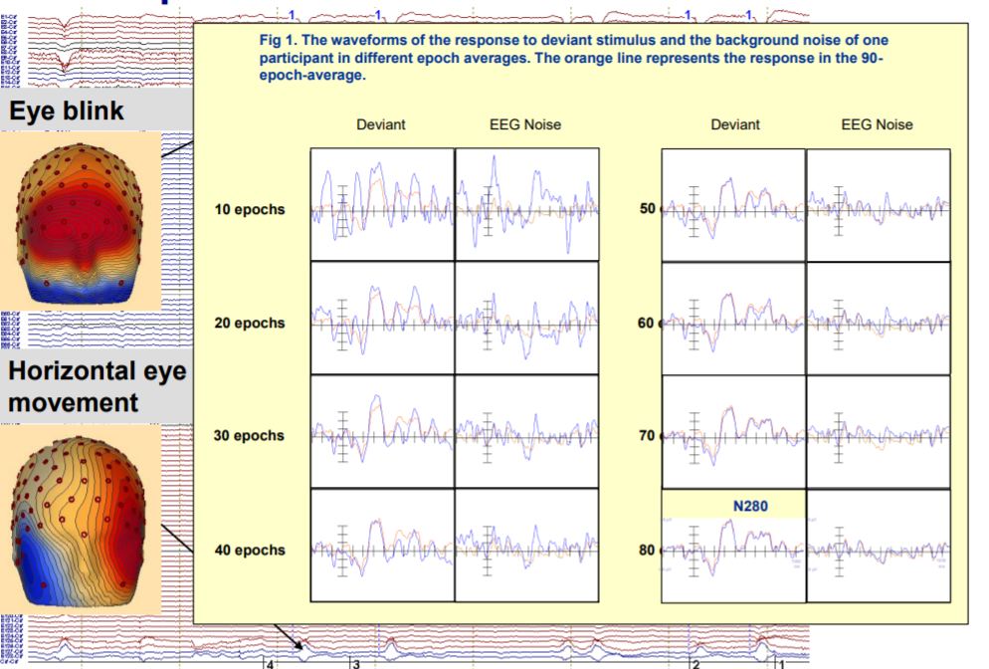
Repetitions: cancel noise, increase signal
Notes:
We see how increased averaging begins approximating the ERP that you get after averaging 90 trials. In the beginning the ‘signal’ is indistinguishable from noise; looks random. With increased averaging, the noise itself cancels out.
Figure from eppanen hamalainen eeg-tool-for-brain

Slide 27
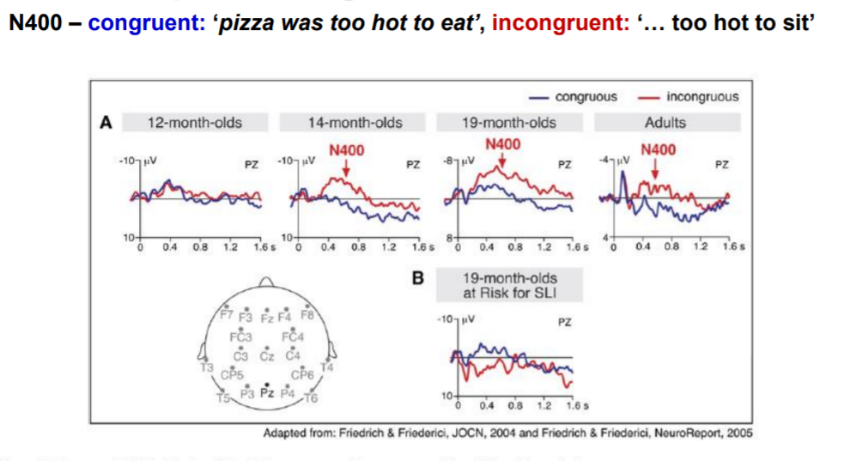
ERP in practice: surprising words.
Notes:
An example of final ERP measured at presentation time of critical word, in different conditions.
Figure from eppanen hamalainen eeg-tool-for-brain

Slide 28
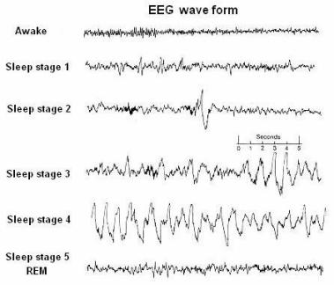
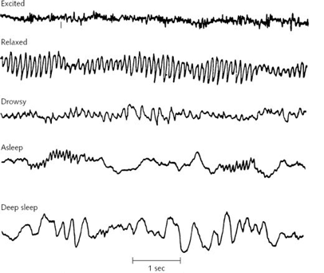
Electroencephalography (EEG)
EEG also contains important information in form of frequency characteristics (cycling rate)
Differentiates sleep stages from awake, and drowsy from alert.

Slide 29
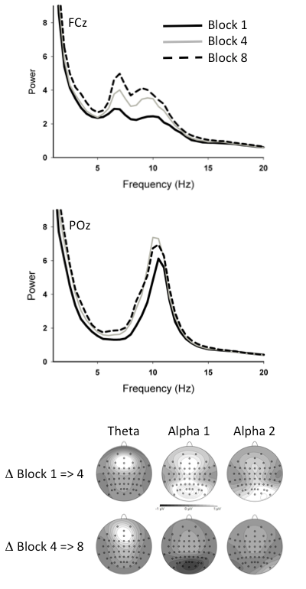
Electroencephalography (EEG) Continued
EEG also contains important information in form of frequency characteristics (cycling rate)
Differentiates sleep stages from awake, and drowsy from alert.
Power plots can show the relative strength of each frequency. To the right: practice (block) effects on power in different frequency bands, sampled at different sensors.

Slide 30
Electroencephalography (EEG)
Frequency bands
Delta (0 – 4 Hz)
Theta (4 – 8 Hz)
Alpha (8 – 12 Hz), Mu (8 – 12 Hz)
Beta (12 – 30 Hz)
Gamma (30 – 80 Hz)
High gamma (80 – 150 Hz)

Slide 31
Understanding the Alpha Band in EEG: An Example of Frequency Band Interpretation
The alpha band in EEG has a frequency range of 8-12 Hz.
It is commonly observed during eyes-closed recordings and relaxed states.
Alpha oscillations are associated with reduced communication between the cortex and thalamus.
During externally oriented attention and stimulus processing, the alpha activity is suppressed.

Slide 32
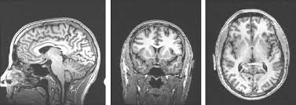
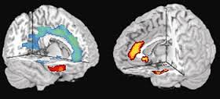
Structural Imaging
Structural imaging involves collecting 3D images of the brain, similar to the images obtained in a medical setting.
This type of imaging can provide information about various aspects of brain structure, such as:
Gray matter volume (i.e., the overall size of the gray matter in the brain).
The density of gray matter in specific regions, which can approximate the concentration of neurons.
Cortical thickness at a resolution of a few millimeters.
Surface area of particular brain regions.

Slide 33
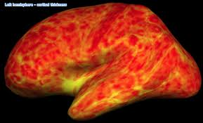
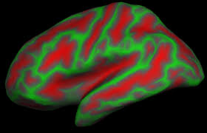
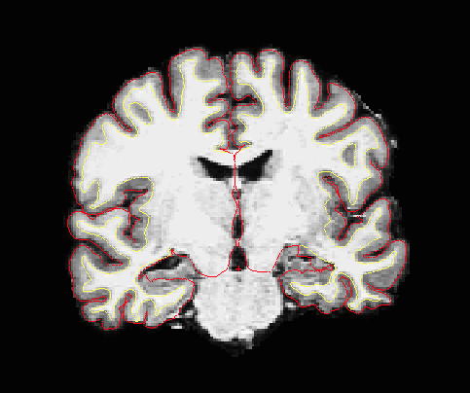
Structural Imaging (2)
Calculation of cortical thickness is usually done by converting the brain's 3D representation to a 2D sheet representation.
The curvature map shows the gyri and sulci.
The upper right image shows a thickness map for a sample participant

Slide 34
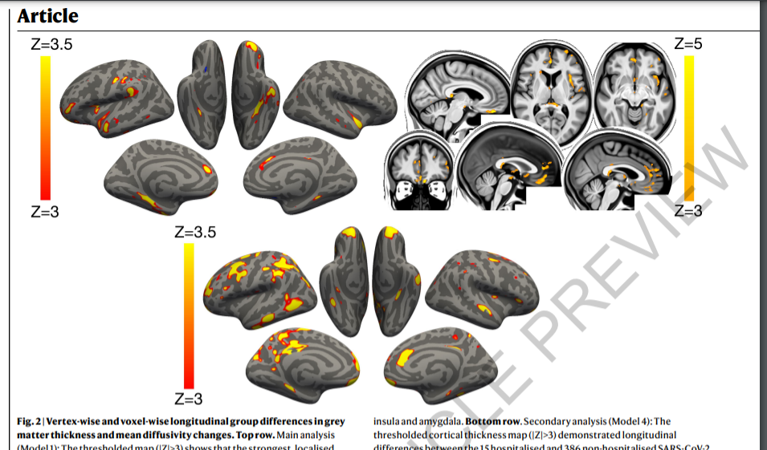
SARS-CoV-2 is associated with changes in brain structure in UK Biobank (2022)
Gray matter thickness (left) and diffusivity (right) effects
Notes:
Upper row: all vs. control. Below; hospitalized vs. not
Fig. 2 | Vertex-wise and voxel-wise longitudinal group differences in grey matter thickness and mean diffusivity changes. Top row. Main analysis (Model 1): The thresholded map (|Z|>3) shows that the strongest, localised reduction of grey matter thickness in the 401 SARS-CoV-2 positive participants compared with the 384 controls are bilaterally in the parahippocampal gyrus, anterior cingulate cortex and temporal pole, as well as in the left orbitofrontal cortex, insula and supramarginal gyrus. Similarly, the strongest longitudinal differences in mean diffusivity (|Z|>3, left is shown on right) could be seen in the orbitofrontal cortex and anterior cingulate cortex, a

Slide 35
Functional MRI
Functional MRI is allows observing which parts of the brain work when we do things like thinking or perceiving.
‘work’ means: are involved in metabolic activity (cell reactions involved in energy release)
In Neuro’, metabolic activity is often as a proxy for neural activity; active neurons require more energy to function and can increase their metabolic rate
fMRI uses a big magnet to affect protons in the brain and then measures how they behave as they return to their original state.
By analyzing the patterns of proton behavior, we can identify which brain areas are more active during certain tasks.
This method gives us very detailed information about where activity is happening in the brain and can help us understand how different regions contribute to complex processes like thinking and perception.

Slide 36
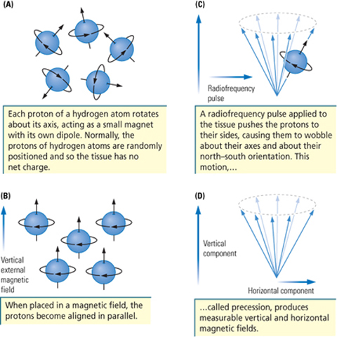
Functional MRI (not for exam)

Slide 37
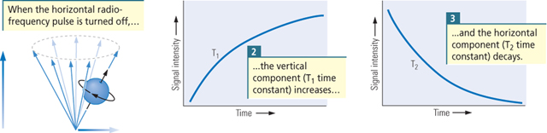
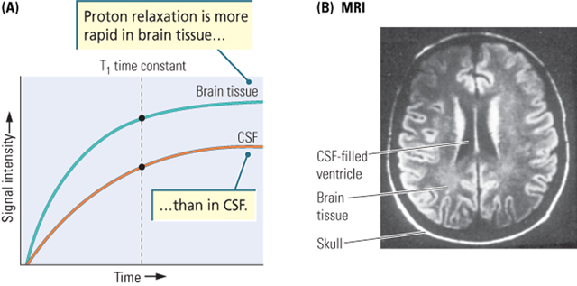
functional MRI (not for exam)

Slide 38
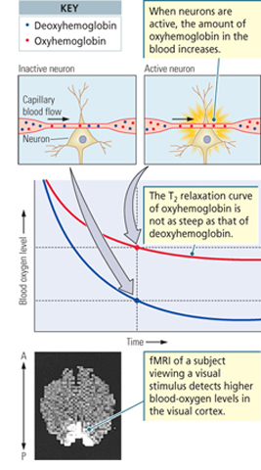
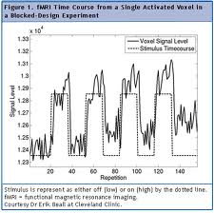
functional MRI (not for exam)
Detects differences in oxygen demand in different brain regions during a task, which results in T2 contrast and identifies active areas.
Provides a time series of brain activity in every brain region, usually at a resolution of 3x3x3mm.
fMRI can also measure the synchronization between different brain regions

Slide 39
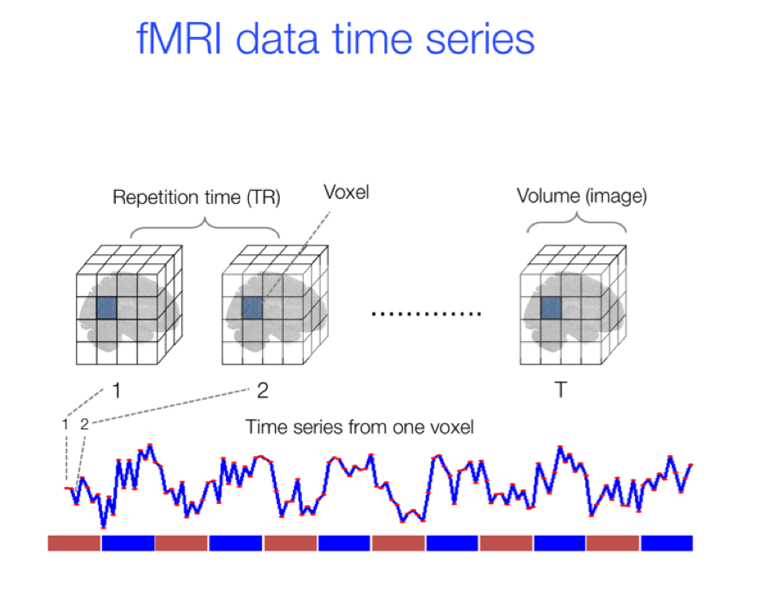
Functional MRI: the time series
Notes:
From - Kashou, A Practical Guide to an fMRI Experiment, Intech Open Science (2013)

Slide 40
Functional MRI: In an experimental context
Signal = Measurable response to stimulus
Noise = Any component of the measurement that interfere with the detection of the signal. Examples of noise in fMRI measurements include motion artifacts, scanner drift, and physiological noise
Statistical detection theory:
Understand relationship between stimulus & signal
Describe noise properties statistically
Devise methods to distinguish noise-only measurements from signal+noise measurements, and assess the methods’ reliability
Adopted from Bob Cox’s “Data Analysis Philosophy” for fMRI

Slide 41
Functional MRI: In an experimental context
FMRI Stimulus -> Signal connection and noise statistics are complex and poorly characterized
We devise, a priori, a mathematical model connecting stimulus (or “activation”) to signal. Frequently, some sort of regression model
We make an estimation of the statistical model for the noise, taking into account whether it is random, structured, oscillatory, etc.
These two models are then combined to produce an equation for measurements given signal+noise, which will also often be a regression model.
The final result is an equation with few free parameters that can be fitted to the data.
Adapted from Bob Cox’s “Data Analysis Philosophy” for fMRI

Slide 42
Functional MRI: In an experimental context
FMRI analysis often fits a (convolved) activation model to each voxel’s time series separately (“massively univariate” analysis)
Pre-processing techniques are applied to reduce noise, including spatial smoothing across nearby voxels.
The outcome of model fitting is a collection of parameters estimated from each voxel's data. The Activation Amplitude (Beta) is the most critical parameter, and it is related to the correlation between the model and activity.
At the group level, the voxel-level estimates are pooled together to reach a group-level conclusion per voxel
Adapted from Bob Cox’s “Data Analysis Philosophy” for fMRI

Slide 43
Functional MRI: In an experimental context
FMRI measures changes in neural activity, not absolute magnitudes.
The baseline signal level in a voxel does not provide information about neural activity.
An experiment using fMRI requires at least two conditions to detect changes in neural activity.
Minimally, experiments use a "task" and "rest" condition.
In a two-task experiment intermixed with rest, a beta value is estimated per task, and their values are contrasted to determine the difference between the two tasks
Adapted from Bob Cox’s “Data Analysis Philosophy” for fMRI

Slide 44
Functional MRI: In an experimental context (not for exam)
Example: Block-trial FMRI data
A long train of stimuli is presented to drive brain activity for extended period, with rest—in between . E.g .10sec on/off cycle.
BOLD (hemodynamic) response accumulates from multiple close-in-time neural activations and is large
Noise magnitude can be similar to BOLD response
Next 2 slides: same brain voxel in 3 (of 9) EPI runs
black curve (noisy) = data
red curve (above data) = ideal model response
blue curve (within data) = model fitted to data
somatosensory task (finger being rubbed)
Adapted from Bob Cox’s “Data Analysis Philosophy” for fMRI

Slide 45
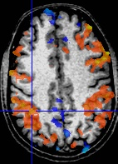
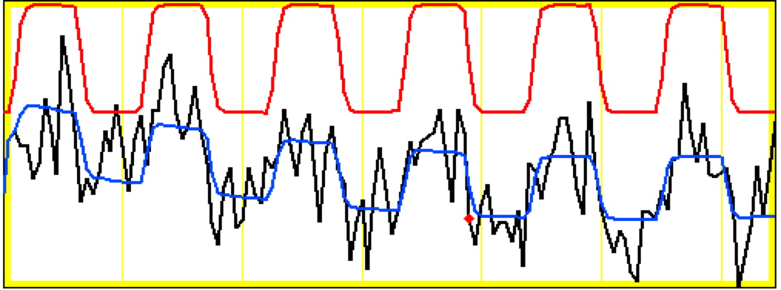
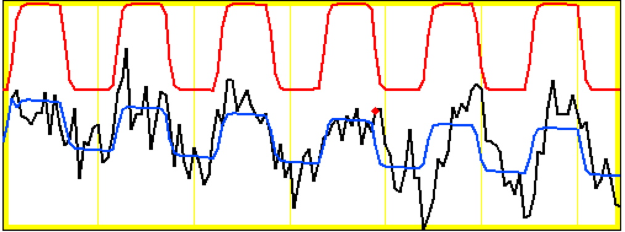
not for exam
Same Voxel: Runs 1 and 2
model regressor
model fitted to data
data
Noise ≈ same size as Δsignal
Block-trials: 27 s “on” / 27 s “off”; TR=2.5 s; 130 time points/run

Slide 46
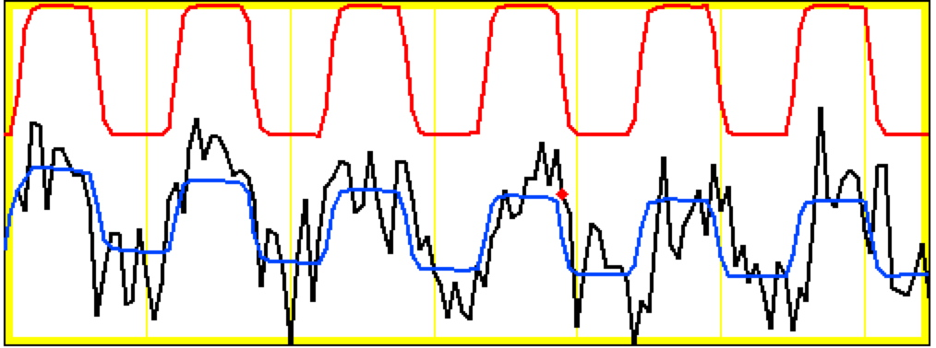
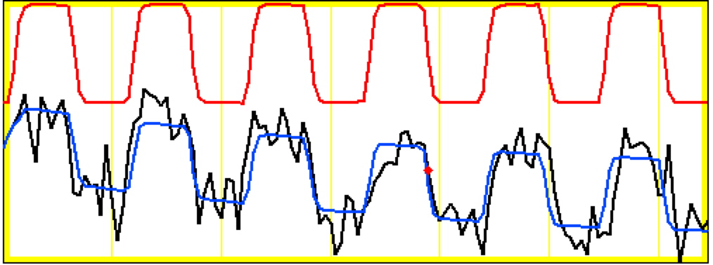
not for exam
Same Voxel: Run 3 and Average of all 9
Activation amplitude & shape vary among blocks! Why???

Slide 47
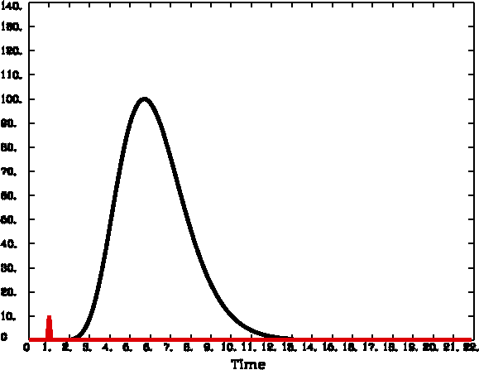
Hemodynamic Response Function (HRF)
HRF is the idealization of measurable FMRI signal change responding to a single activation cycle (up and down) from a stimulus in a voxel
Response to brief activation (< 1 s):
delay of 1-2 s
rise time of 4-5 s
fall time of 4-6 s
model equation:
h(t ) is signal change t seconds after activation
1 Brief Activation (Event)

Slide 48
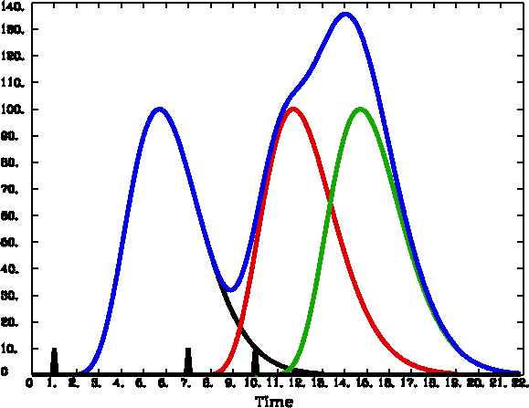
Linearity (Additivity) of HRF
not for exam
Multiple activation cycles in a voxel, closer in time than duration of HRF: Assume that overlapping responses add
Linearity is a pretty good assumption
But not apparently perfect — about 90% correct
Nevertheless, is widely taken to be true and is the basis for the “general linear model” (GLM) in FMRI analysis
3 Brief Activations

Slide 49
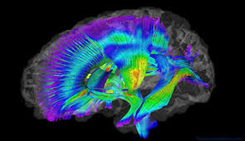
Diffusion weighted imaging (DTI)
Diffusion weighted imaging, also known as Diffusion MRI or Diffusion Tensor Imaging, is used to examine the structure of white matter fibers.
For each voxel, the preferred direction of diffusion and the strength of diffusion are estimated to determine white matter tracts.
These connections are considered ‘hardwired’ connections. They can be cross-referenced against functional connectivity.

